Slide 1
ClickWise: A Smart Tracker for Detecting Productivity Dips
TEAM MEMBERS:
1.MAHMOOTHA MURSHITHA M 2.PAVITHRA S 3.PRITHIKA VAISHNAVI V U

Slide 2
Abstract / Problem Statement
In today’s digital work environment, maintaining consistent productivity is a challenge. Frequent task-switching, distractions, and prolonged inactivity can lead to dips in focus and output. Current productivity trackers often lack real-time insights or contextual understanding. There is a need for an intelligent, real-time system that can track digital activity and detect signs of declining productivity by analyzing mouse clicks, typing behavior, and screen interactions to enable proactive measures.

Slide 3
Objective
To develop a smart productivity monitoring tool that detects dips in user engagement using clickstream and behavioral data.
To provide real-time feedback and visual analytics to help users optimize focus and manage digital habits.
To detect patterns of low productivity and notify users or log them for review.

Slide 4
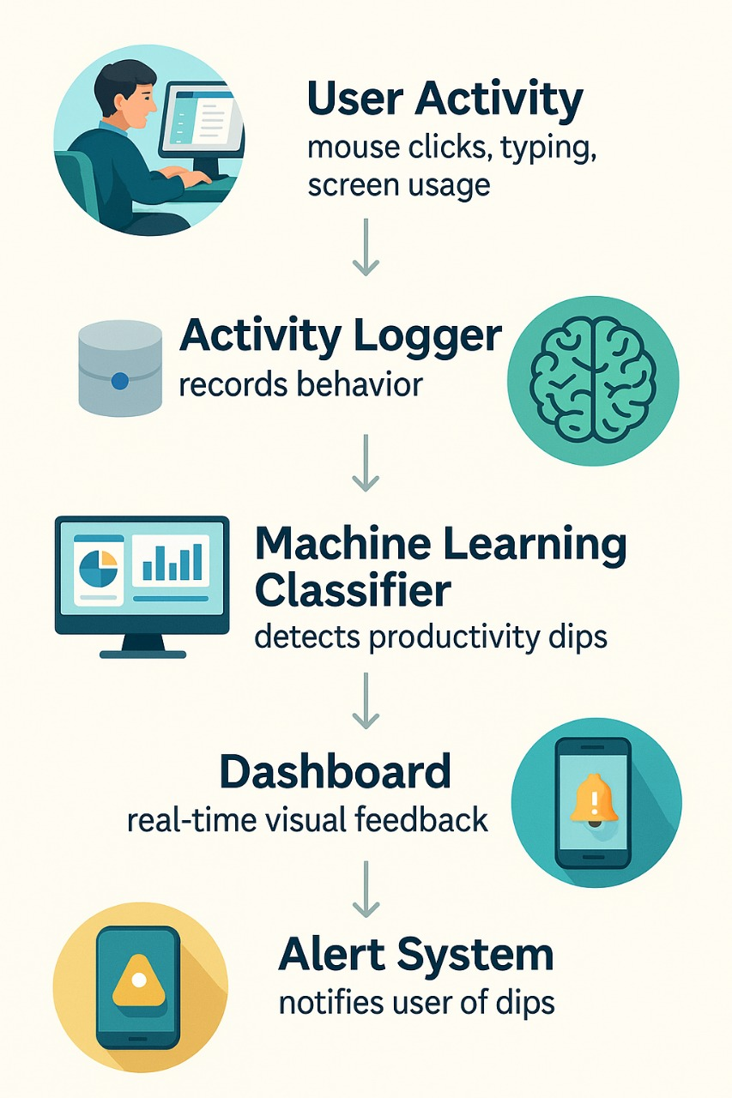
Domain Overview

Slide 5
literature review
S.No | Paper Title | Journal (Year) | Description | Algorithms | Tools Used | Merits | Demerits
1 | Smart Work Pattern Monitoring Using Mouse Dynamics | IEEE Access (2024) | Detects fatigue using mouse clicks and movement patterns | SVM | Python, SciKit-learn | High accuracy in mouse-based behavior detection | Limited to mouse activity
2 | AI-Based Productivity Detection in Remote Workers | Springer AI & Society (2025) | Classifies productivity from typing, session, and app usage logs | Random Forest | Python, TensorFlow | Tracks multiple behavior metrics | High resource usage; privacy concerns
3 | Detecting Micro-Breaks via Keystroke Patterns | Elsevier CHB (2024) | Uses typing rhythm to detect micro-breaks and attention lapses | KNN, K-Means | Pandas, PyCaret | Non-intrusive and keyboard-based | Ignores visual/context distractions
4 | Clickstream Analysis for Employee Monitoring | ACM TOCHI (2025) | Analyzes browser clickstream for productivity patterns | Decision Trees | Streamlit, Flask | Scalable, easy dashboard integration | Raises ethical/monitoring concerns
5 | Time-Series Classification of Productivity Patterns | IEEE Sensors Journal (2024) | Detects dips using time-series behavior across work hours | LSTM, CNN | PyTorch, NumPy | Accurate long-term trend detection | Needs large and consistent data

Slide 6
Technology Stack
Frontend:
Streamlit (for dashboard interface)
Backend:
Python (Flask/Streamlit backend logic)
Data Collection:
Python scripts for click/key logger (non-intrusive)
Database:
SQLite / MongoDB (for user log storage)
Machine Learning:
Scikit-learn, Pandas (for detection of dips)
Visualization:
Plotly / Seaborn (activity graphs)

Slide 7
System Architecture
User Device
Mouse, keyboard, screen tracking
Activity Logger
Logs click frequency, idle time, window switching
ML Model
Analyzes data to detect productivity dips
Database
Stores logs and model outputs
Dashboard (Streamlit)
Displays insights, alerts, and history

Slide 8
Conclusion
ClickWise offers a lightweight, intelligent, and real-time solution for detecting productivity dips in digital environments.
It integrates behavioral tracking with machine learning to personalize alerts and productivity suggestions.
The system is scalable, customizable, and applicable in both educational and corporate settings.
Future work involves integrating eye tracking and sentiment analysis for deeper insights.

